Slide 1
Regional Association of Oil, Gas and Biofuels Sector Companies In Latin America and the Caribbean
Institutional Experience in the use of the Readiness Evaluation Tool for Oil Spills
Miguel Moyano | Executive Secretary
Sub-regional Workshop on the assessment of the level of oil spill response planning and readiness management for the Central and Eastern Mediterranean
23 November 2021

Slide 2
REGIONALIZATION
WHAT IS IT?
In the context of spill response, regionalization embodies a cooperative approach to sharing knowledge, information, personnel, equipment and materials among the relevant stakeholders, in identifiable regions.

Slide 3
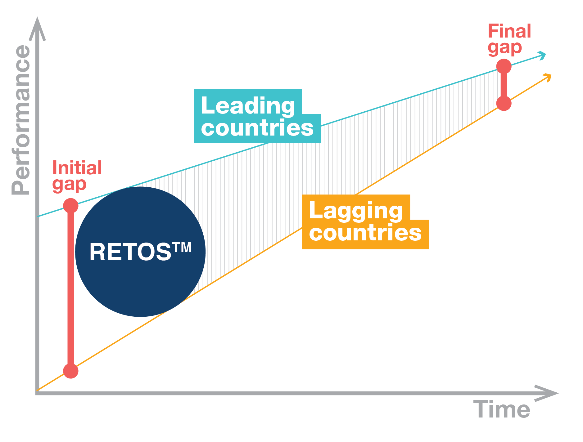
REMPEC and the use of ARPEL RETOS™ tool for cooperation objectives
Industry/government harmonization of oil spill preparedness and response approaches and evaluation
Improved performance and reduced learning curve using RETOS™ as a standard

Slide 4
RETOS™ and regional cooperation
Baltic Sea + USA
Source: Jonas Palsson et al, “Comparing Swedish oil spill preparedness to regional countries using the RETOS™ evaluation tool” – 2017 IOSC

Slide 5
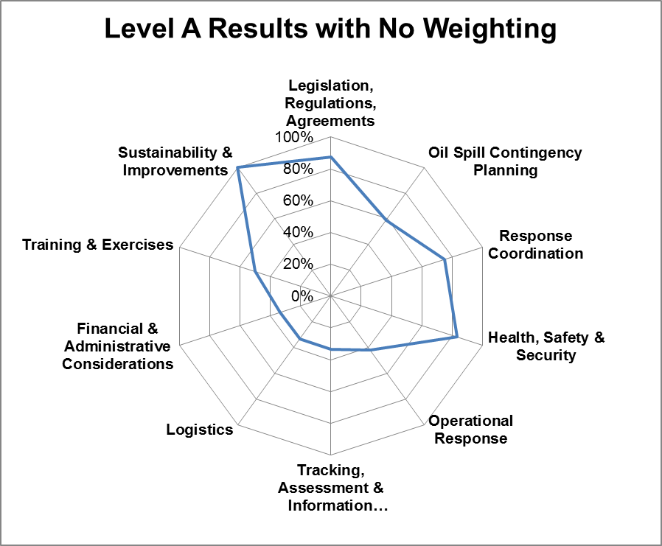
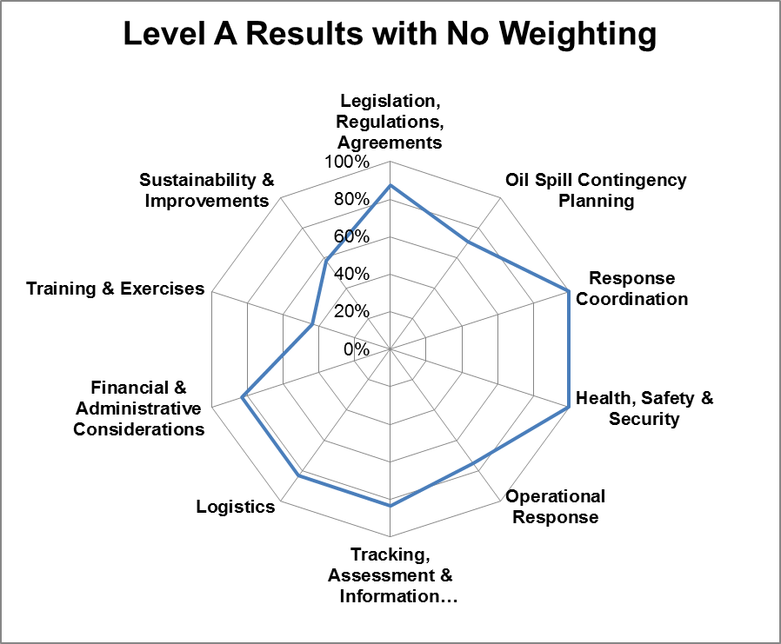
RETOS™ and regional cooperation
Partner A
Partner B
Legislation, Regulations & Agreements
Oil Spill Contingency Planning
Response Coordination
Health, Safety & Security
Operational Response
Tracking, Assessment, and Information Management
Logistics
Financial and Administrative Considerations
Training & Exercises
Sustainability & Improvement

Slide 6
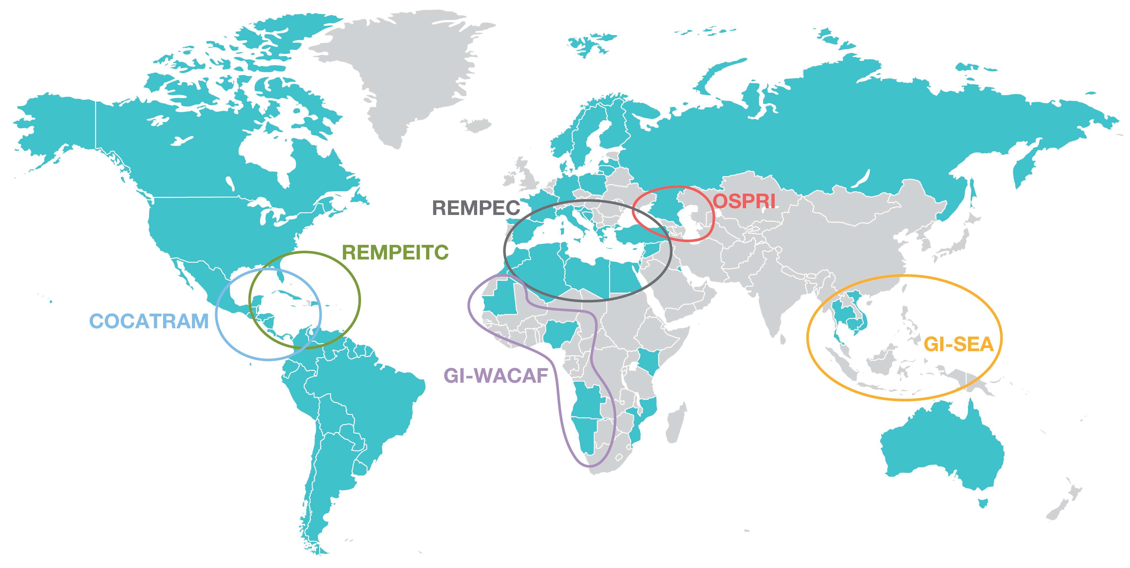
International Adoption of ARPEL RETOS™ tool:
Benchmarking of NOSCP’s
RETOS™ is used by governments and companies in more than 79 countries in the 5 continents

Slide 7
REGIONALIZATION
In the context of spill response, regionalization embodies a cooperative approach to sharing knowledge, information, personnel, equipment and materials among the relevant stakeholders, in identifiable regions.

Slide 8
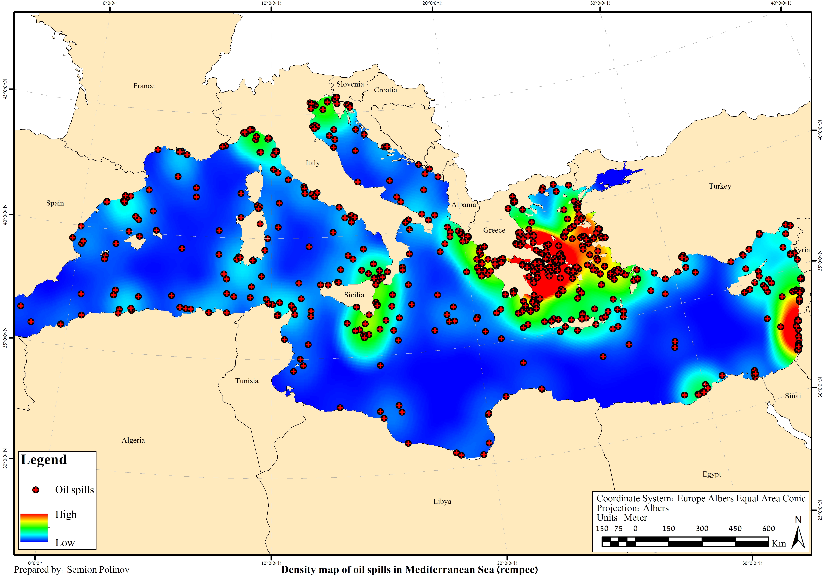
REGIONALIZATION
WHERE?
COMMON RISK RATIONALE
In 2016, Tourism contributed to create 333.2 billion US$ in the Mediterranean countries

Slide 9
KEY MESSAGES
RETOS™ is internationally utilized as the cornerstone of regional organizations and initiatives to advance its members’ oil spill preparedness and response through cooperation
REMPEC is key to coordinate the multi-institutional process required to accomplish and implement cooperation mechanisms in the Mediterranean Sea

Slide 10
ARPEL 2021
THANK YOU
www.arpel.org
@ARPEL_Petroleo
/company/arpel
Canal ARPEL

